Slide 1

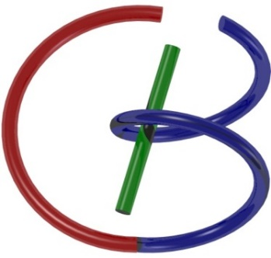
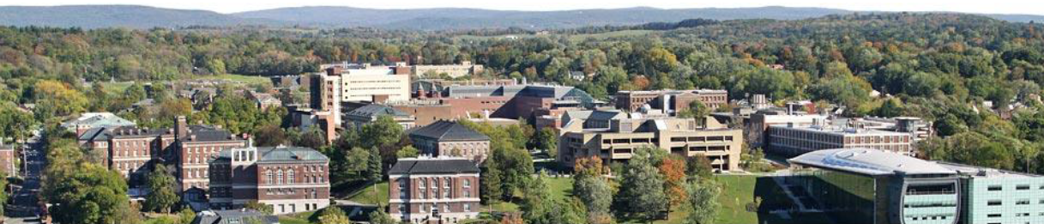
Idea on Sparsity
Ge Wang
AI-based X-ray Imaging System (AXIS) Lab
Rensselaer Polytechnic Institute, Troy, New York, USA
October 29, 2021

Slide 2
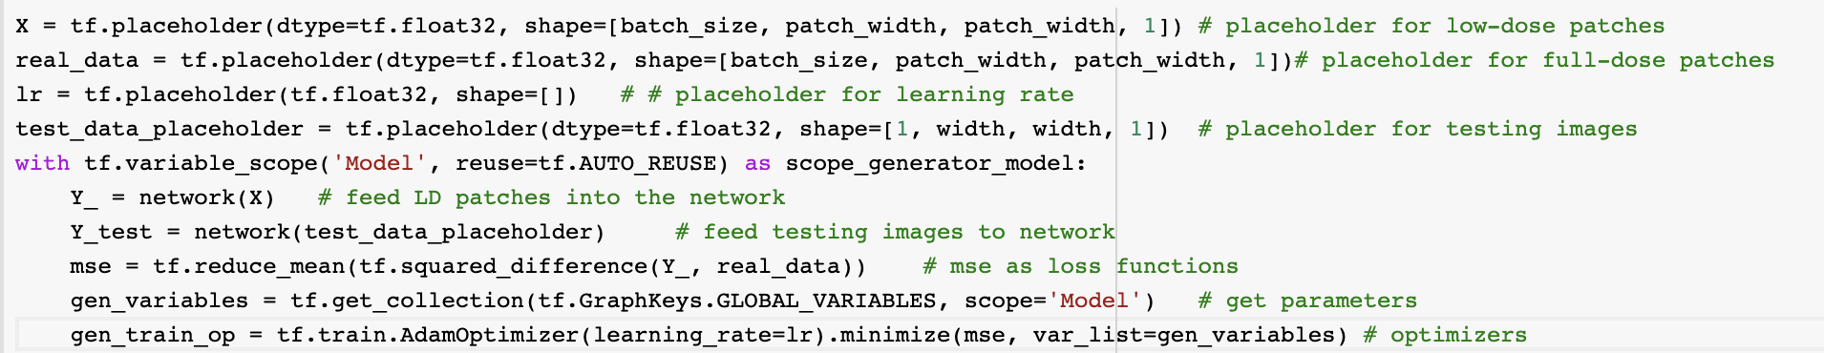
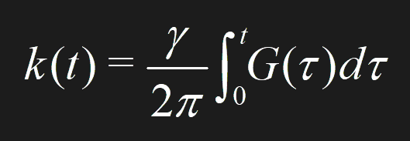
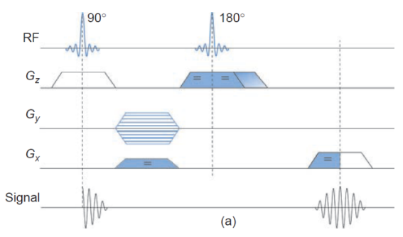
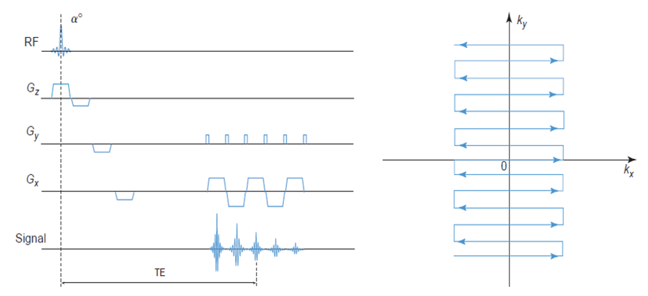
Answers for you to review
Question # | 1 | 2 | 3 | 4 | 5 | 6 | 7 | 8 | 9 | 10 | 11 | 12 | 13 | 14 | 15 | 16 | 17 | 18 | 19 | 20 | 21 | 22 | 23 | 24
Answer Key | B | C | C | 5 | 3 | C | D | 2 | D | 315 | A | C | 43125 | D | A | C | C | 26 | FTTF | A |  |  |  | 2
# of Points | 2 | 2 | 2 | 2 | 2 | 4 | 2 | 2 | 2 | 2 | 4 | 4 | 10 | 2 | 2 | 2 | 2 | 4 | 8 | 2 | 4 | 4 | 4 | 2

Slide 3
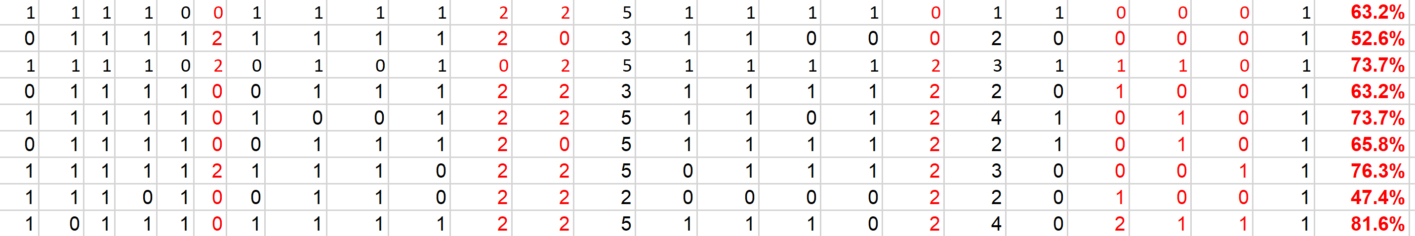
F21 MiMi Midterm Grading Results
We have 9 students. As I said, I believe that the mean score of a well-design exam should be 50%, and I will make sure
a reasonable grade distribution. As far as this midterm is concerned, the lowest should be C, above 70% should be A. Hence, you have a feeling about your relative position now.

Slide 4
MI Schedule for F21
Tue | Topic | Fri | Topic
08/31 | Introduction | 09/03 | Neuron, Network & Backpropagation
09/07 | No Class | 09/10 | Hands-on 1: Python, Colab, & TensorF
09/14 | Architectures & Training | 09/19 | Hands-on 2: MNIST Classification
09/21 | Image Quality I | 09/24 | CT Physics
09/28 | CT Reconstruction | 10/01 | Deep CT Reconstruction
10/05 | Hands-on 3: CT Networks | 10/08 | More CT Contents
10/12 | MRI Physics | 10/15 | Spin-Echo
10/19 | K-Space Theorem | 10/22 | More MRI Contents
10/26 | Mid Exam | 10/29 | Deep MRI Reconstruction
11/02 | Hands-on 4: MRI Networks | 11/05 | Nuclear Physics
11/09 | Nuclear Imaging | 11/12 | US Imaging
11/16 | Optical Imaging | 11/19 | Multimodality Imaging
11/23 | Hands-on 5: Image Conversion | 11/26 | Thanksgiving
11/30 | Image Quality II | 12/03 | Stability, Interpretability, & Others
12/07 | Overview | 12/10 | Final Exam
Office Hour: Teaching Day 5-6pm: https://rensselaer.webex.com/meet/wangg6

Slide 5
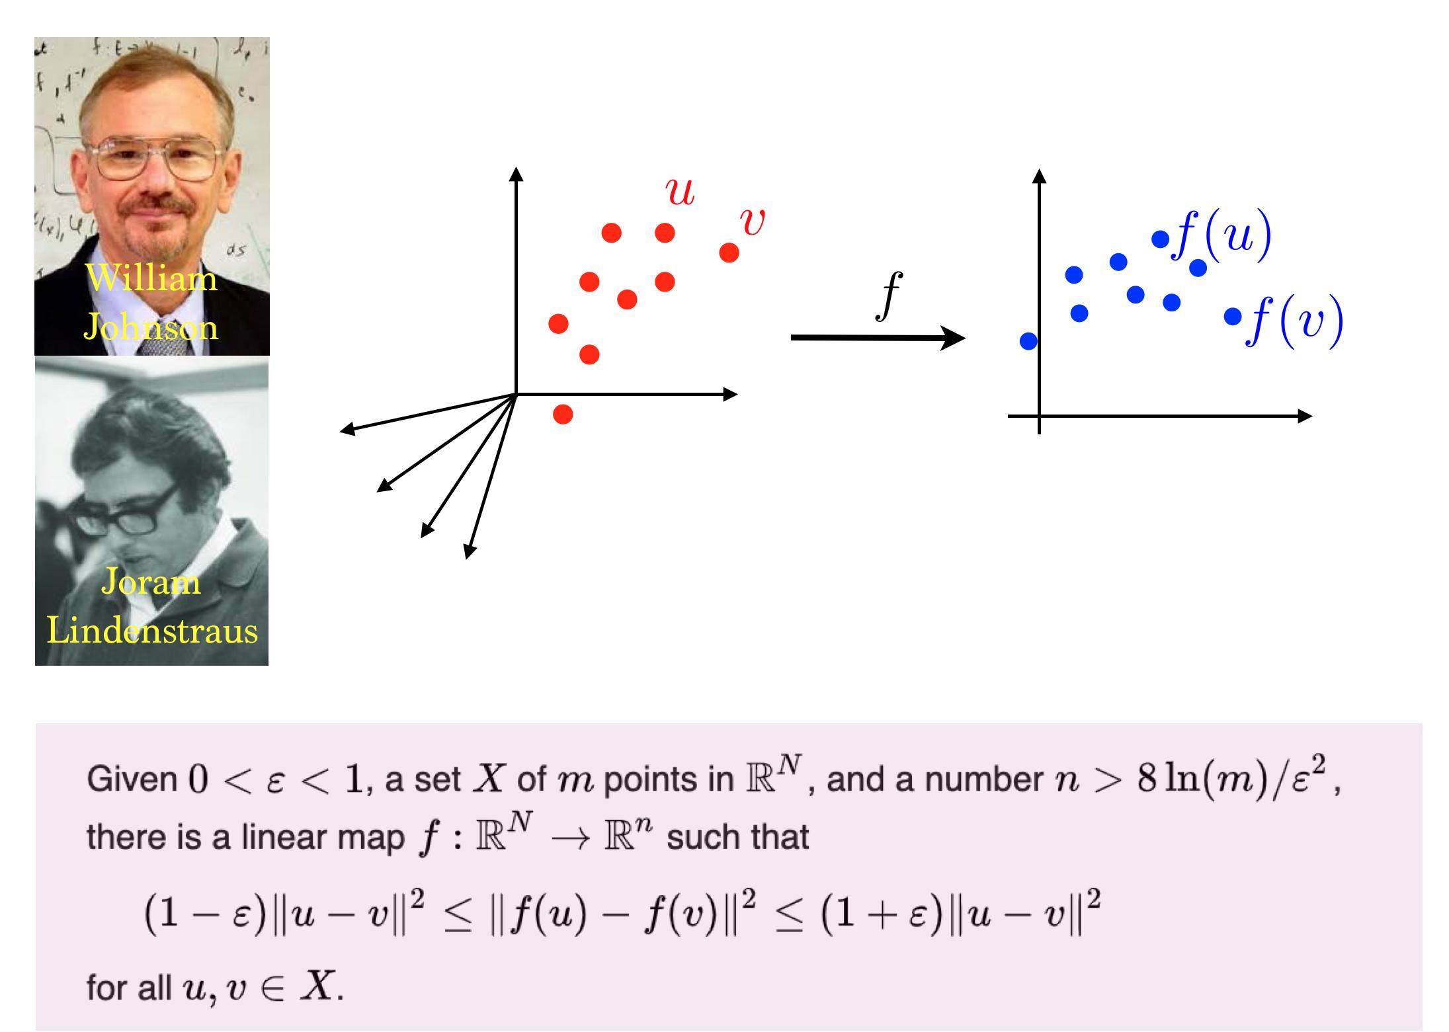
Johnson-Lindenstrauss Lemma
https://twitter.com/gabrielpeyre/status/1178534938850795520/photo/1

Slide 6
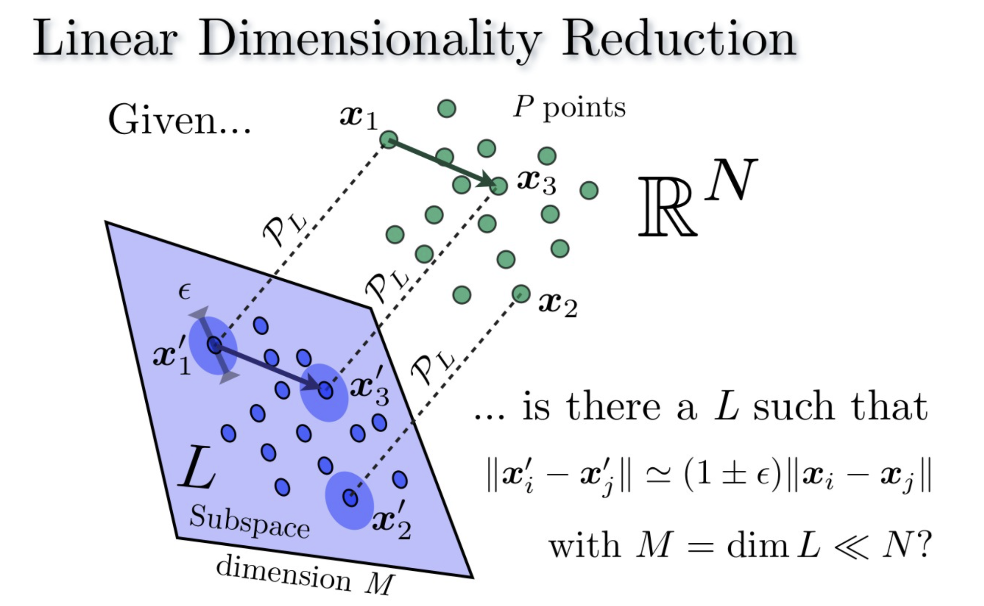
https://www.cantorsparadise.com/the-johnson-lindenstrauss-lemma-3058a123c6c

Slide 7
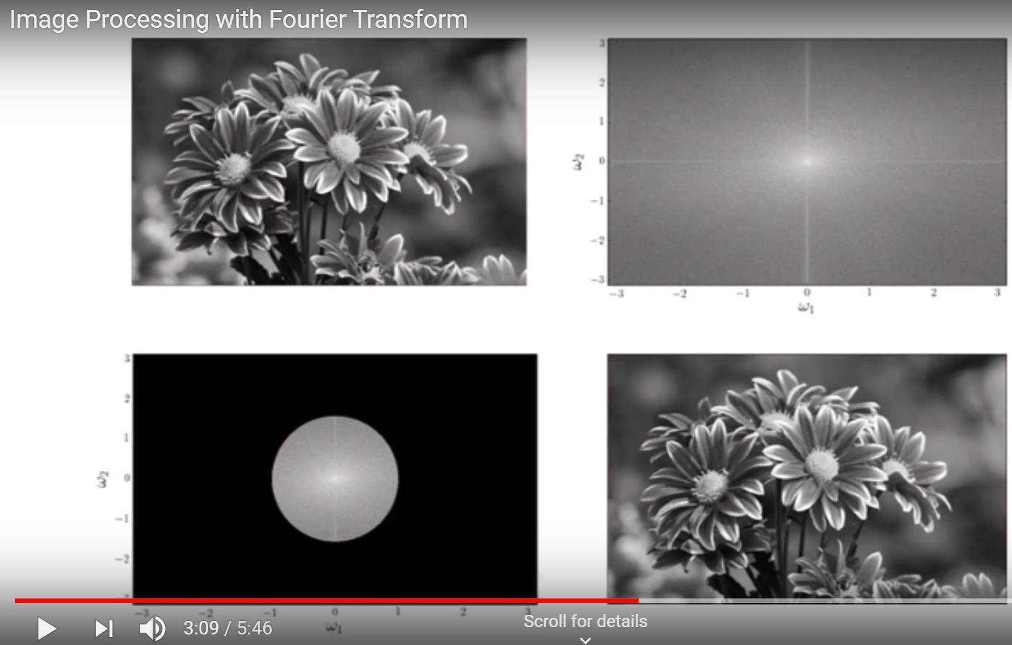
Image Compression Using Fourier Transform
https://www.youtube.com/watch?v=oACegp4iGi0

Slide 8
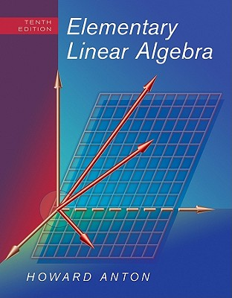
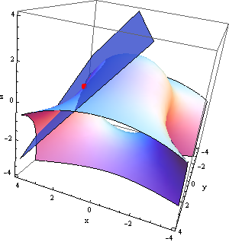
Revisit to Solution of a Linear System
Ax=y
How to solve a system of linear equations if the unknown vector is sparse?
Notes:
Linear algebra used to be considered as a well matured branch of mathematics. Even real relationships are nonlinear, most cases we do linear approximation to obtain a system of linear equations. In the classic setting, we want to find a unknown vector x of N elements. The hint leading to exciting CS development is the question what if we know the unknown vector x is k-sparse? That is, there are at most k elements in x that are nonzero.

Slide 9
Linear Model with Sparsity
Sparsity=k
Signal
Representation Matrix
Sparsifying transform, such as Fourier transform and a gradient (derivative) operation
Measurement Matrix
Tomographic imaging can be modeled in this way
CS Matrix

Slide 10
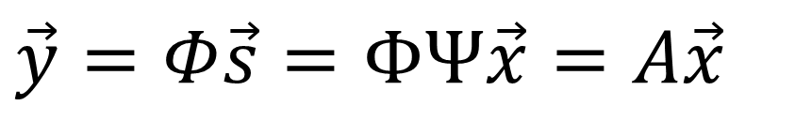
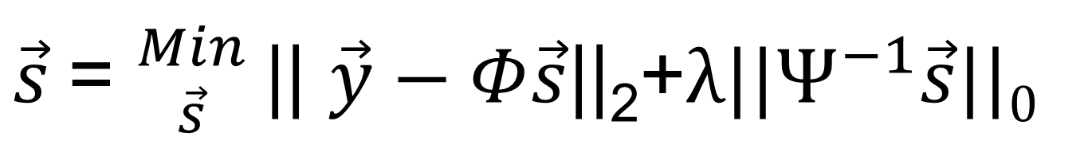
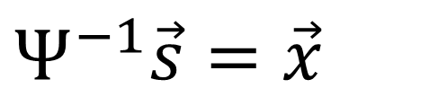
Objective Function for Image Reconstruction
$$\vec{y}=Φ\vec{s}=ΦΨ\vec{x}=A\vec{x}$$
$$Ψ^{−1}\vec{s}=\vec{x}$$
Measurement
Sparsifying
$\vec{s}$= ${Min \atop \vec{s}}$|| $\vec{y}−Φ\vec{s}$||₂+${λ||Ψ}^{−1}\vec{s}||0$
Objective Function consists of two terms:
The first is data fidelity
The second is prior information

Slide 11
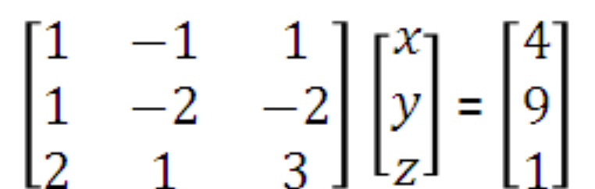
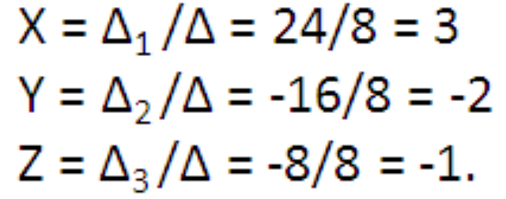
High School Algebra Revisit
With 1-sparse prior & 1 equation
x-y+z=4, we have 3 solutions
(4, -4, 4)
With 1-sparse prior & 2 equations
x-y+z=4, and
x-2y-2z=8
we have the unique solution (in this case, y=-4)!

Slide 12
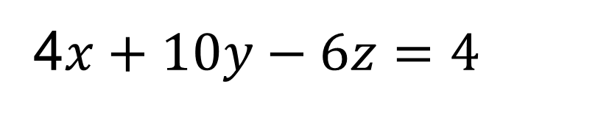
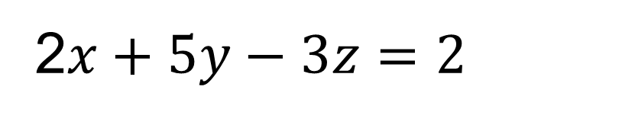
Further Analysis on Case of Sparsity = 1
2$x+5y−3z=2$
x=1 or y=1/5 or z=-1/3?
4$x+10y−6z=4$
x=1 or y=1/5 or z=-1/3?
The 2nd measurement equation gives no new information!

Slide 13
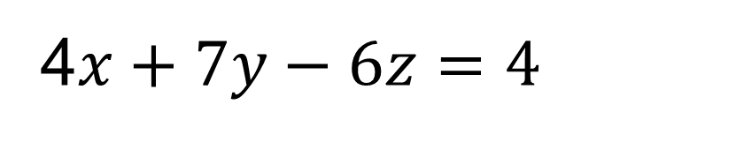
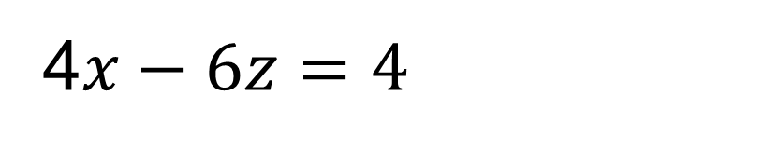
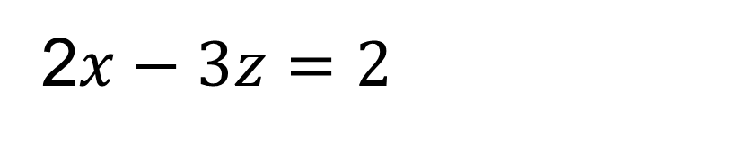
Further Analysis on Case of Sparsity = 1
2$x+5y−3z=2$
x=1 or y=1/5 or z=-1/3?
4$x+7y−6z=4$
If we assume z=0, then x=1 but if we assume y=0, we are not sure if x=1 or z=-1/3? This is because
2$x−3z=2$
4$x−6z=4$
The 2nd measurement gives no new info!

Slide 14
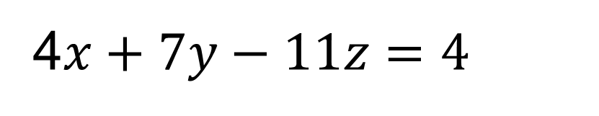
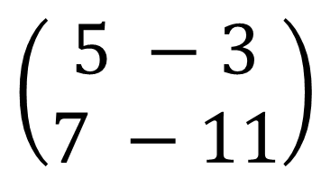
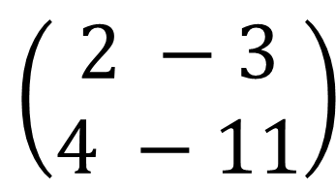
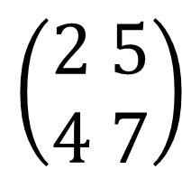
Further Analysis on Case of Sparsity = 1
2$x+5y−3z=2$
4$x+7y−11z=4$
Then, the only solution is x=1 because submatrices are all good (proper, nonsingular)
$$\left(\begin{aligned}2 5 \\ 4 7\end{aligned}\right)$$
$$\left(\begin{aligned}2 −3 \\ 4 −11\end{aligned}\right)$$
$$\left(\begin{aligned}5 −3 \\ 7 −11\end{aligned}\right)$$

Slide 15
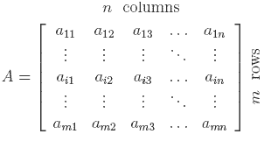
Null Space, Necessity & Sufficiency
2k
Null Space
No Significant Info on x
Necessity: A has m≥2k rows (otherwise A(x₁-x₂)=0)
The difference of two k-sparse vectors can be 2k-sparse. A 2k-sparse vector cannot be uniquely determined if A contains less than 2k rows (that is, we cannot uniquely find a k-sparse vector).
Sufficiency: All mx2k sub-matrices are full rank (thus x₁≠x₂ can be always separated)
A k-sparse vector can be uniquely determined if the null space of A contains no 2k-sparse vectors (that is, A(x₁-x₂) cannot be zero if two k-sparse vectors are not the same, because we can solve the linear system to find the unique solution (all other k-sparse vectors won’t give the same data).

Slide 16
Algebraic View of Compressive Sensing
2k
Necessity: A has m≥2k rows (otherwise A(x₁-x₂)=0)
Sufficiency: All mx2k sub-matrices are full rank
(thus x₁≠x₂ can be always separated)
Restricted Isometry Property:
(stable embedding R^{n}→R^{m} for robust recovery)
L₁ Minimization: Much more efficient than L₀ minimization
Sparsity=k
Notes:
This is my most favorite slide in this talk which gives you all the essential ideas behind CS. By a simple linear algebraic argument, we see that the number of rows m in the system matrix A must be no less than 2k; otherwise, we will not be able to distinguish all pairs of k-sparse vectors. Hence, 2k is the necessary condition for CS. On the other hand, if m is indeed no less than 2k, and all m by 2k sub-matrices are full rank, any pair of non-identical k-sparse vectors can be always separated. That is, 2k is sufficient. Then, we ask distance between two points in the object space will not be changed too much in the measurement space. Quantitatively, we demand a restricted isometry property. In other words, we request a stable embedding from R**n to R**m for robust performance of CS. Then, CS is nothing but the L0 norm minimization problem, which can be efficiently solved using the L1 minimization as proxy of L0 minimization.

Slide 17
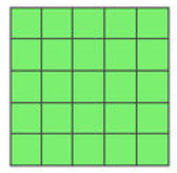
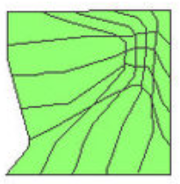
Restricted Isometry Property
Restricted Isometry Property:
(stable embedding R^{n}→R^{m} for robust recovery)
L₁ Minimization: Much more efficient than L₀ minimization
Notes:
This is my most favorite slide in this talk which gives you all the essential ideas behind CS. By a simple linear algebraic argument, we see that the number of rows m in the system matrix A must be no less than 2k; otherwise, we will not be able to distinguish all pairs of k-sparse vectors. Hence, 2k is the necessary condition for CS. On the other hand, if m is indeed no less than 2k, and all m by 2k sub-matrices are full rank, any pair of non-identical k-sparse vectors can be always separated. That is, 2k is sufficient. Then, we ask distance between two points in the object space will not be changed too much in the measurement space. Quantitatively, we demand a restricted isometry property. In other words, we request a stable embedding from R**n to R**m for robust performance of CS. Then, CS is nothing but the L0 norm minimization problem, which can be efficiently solved using the L1 minimization as proxy of L0 minimization.

Slide 18
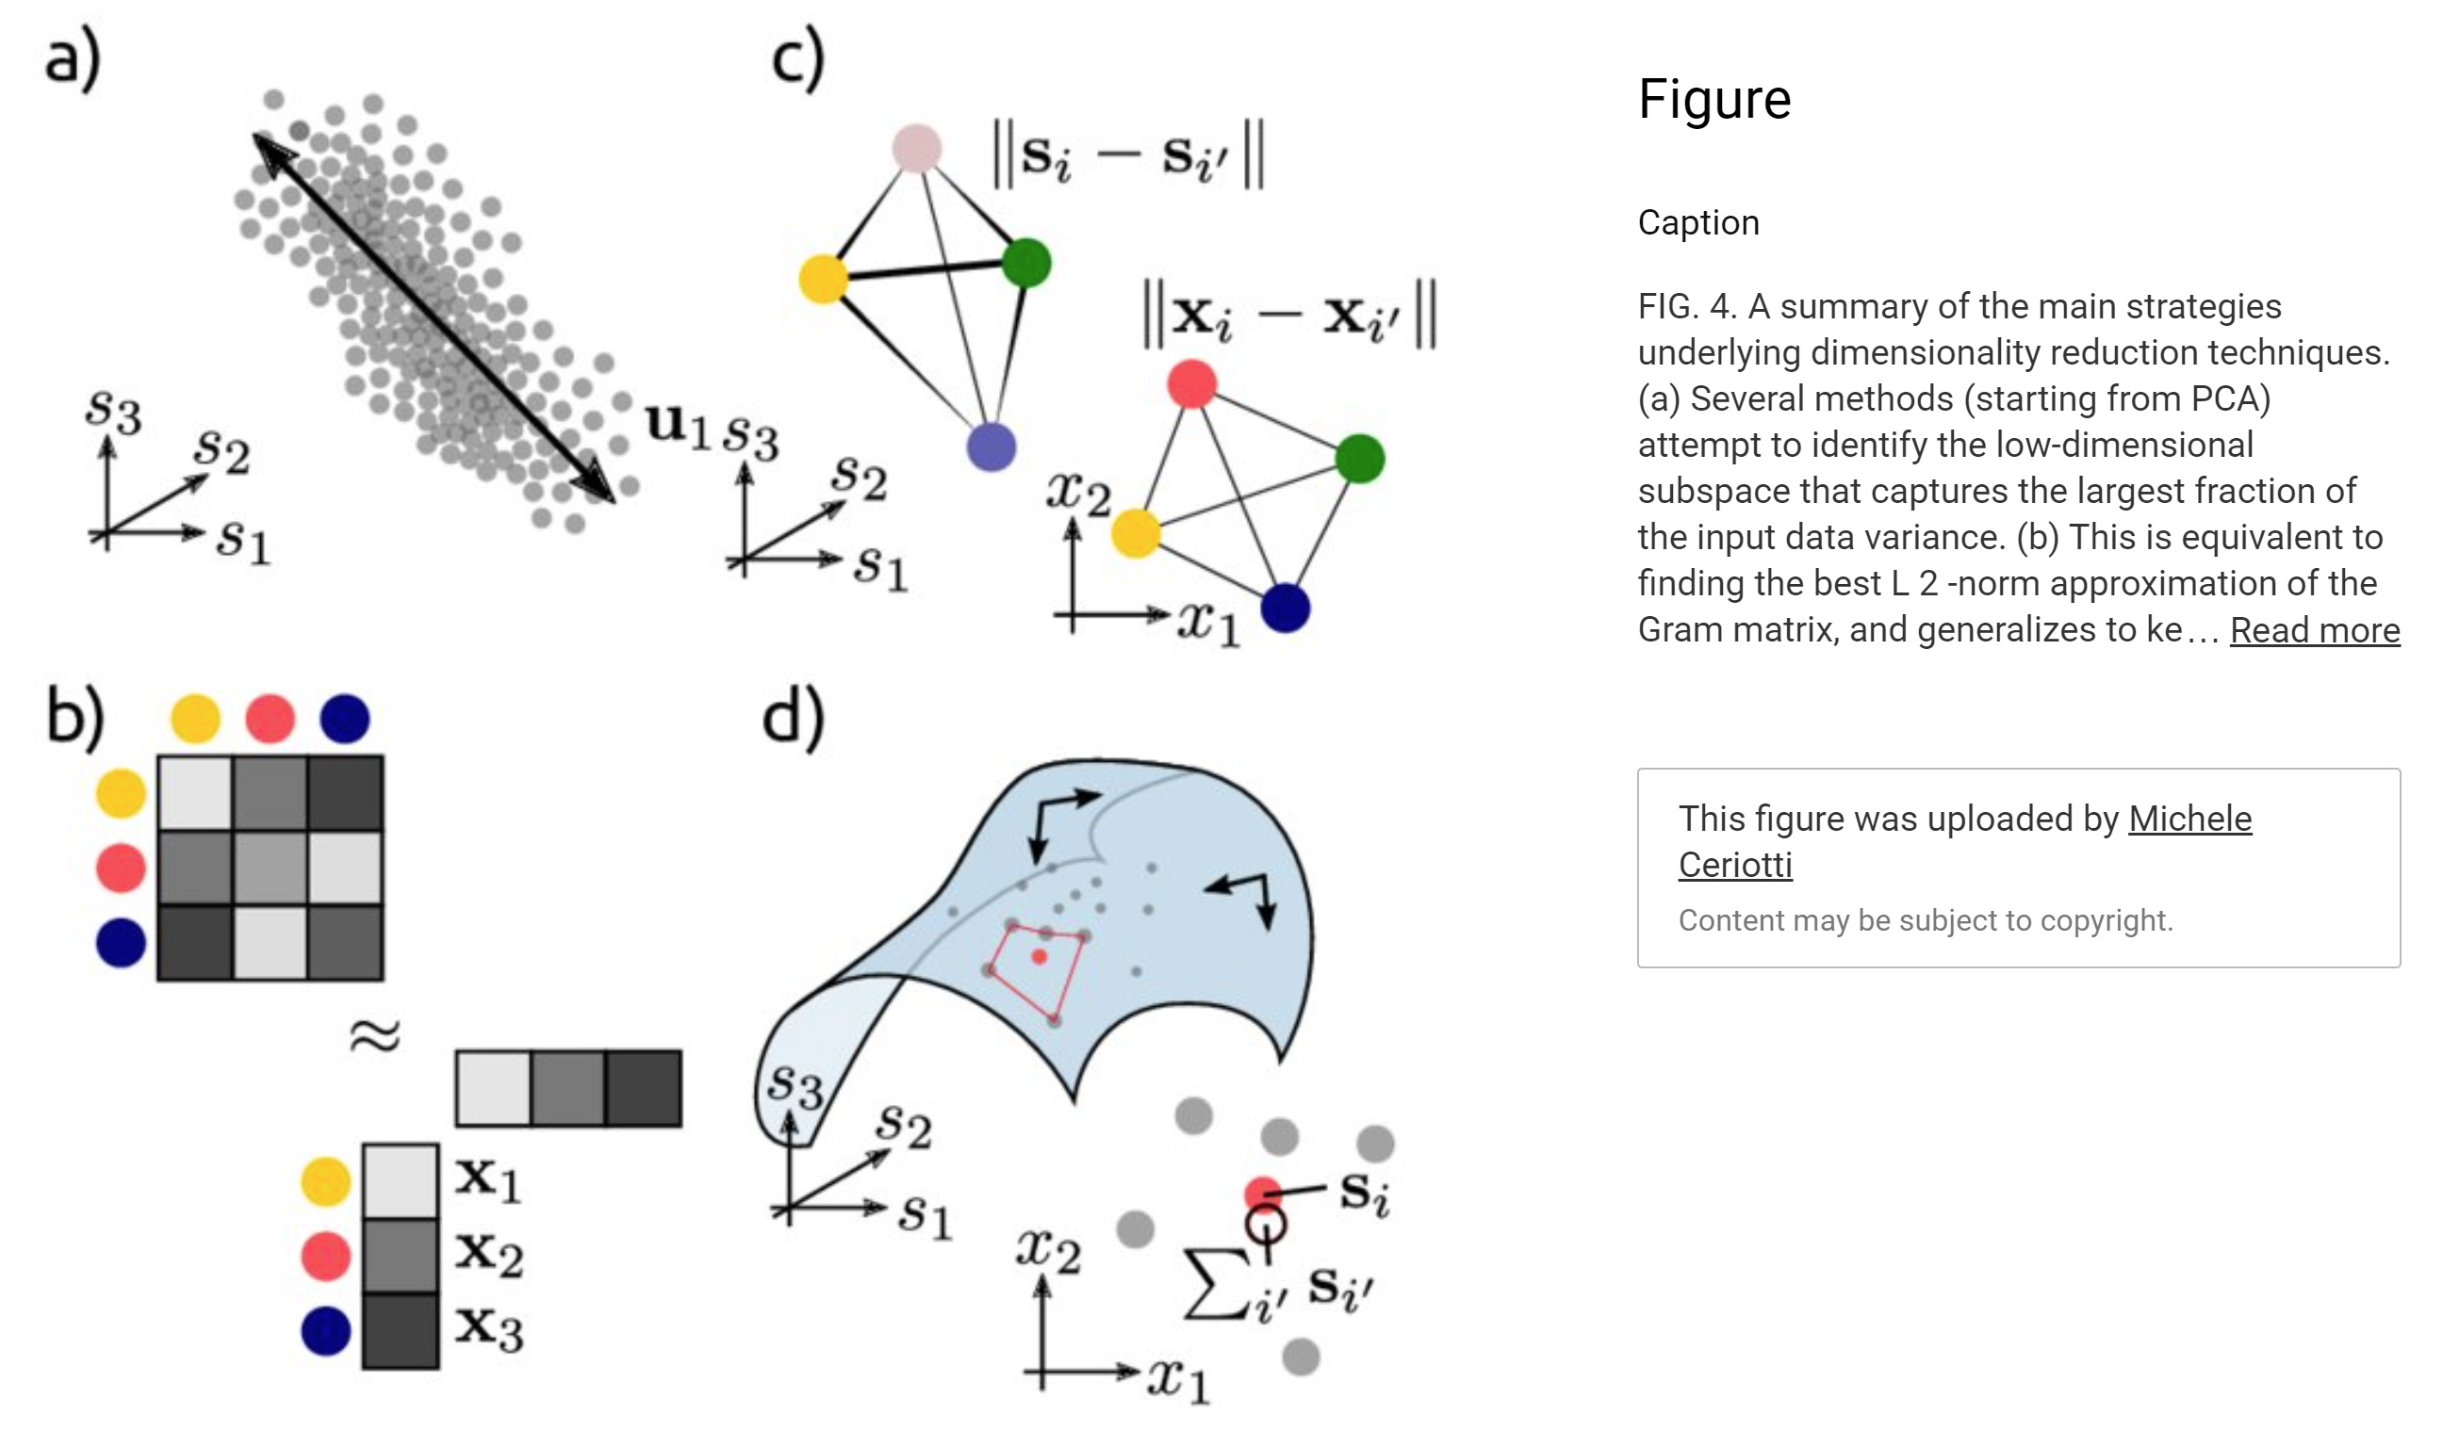
Dimensionality Reduction
https://aip.scitation.org/doi/10.1063/1.5091842

Slide 19
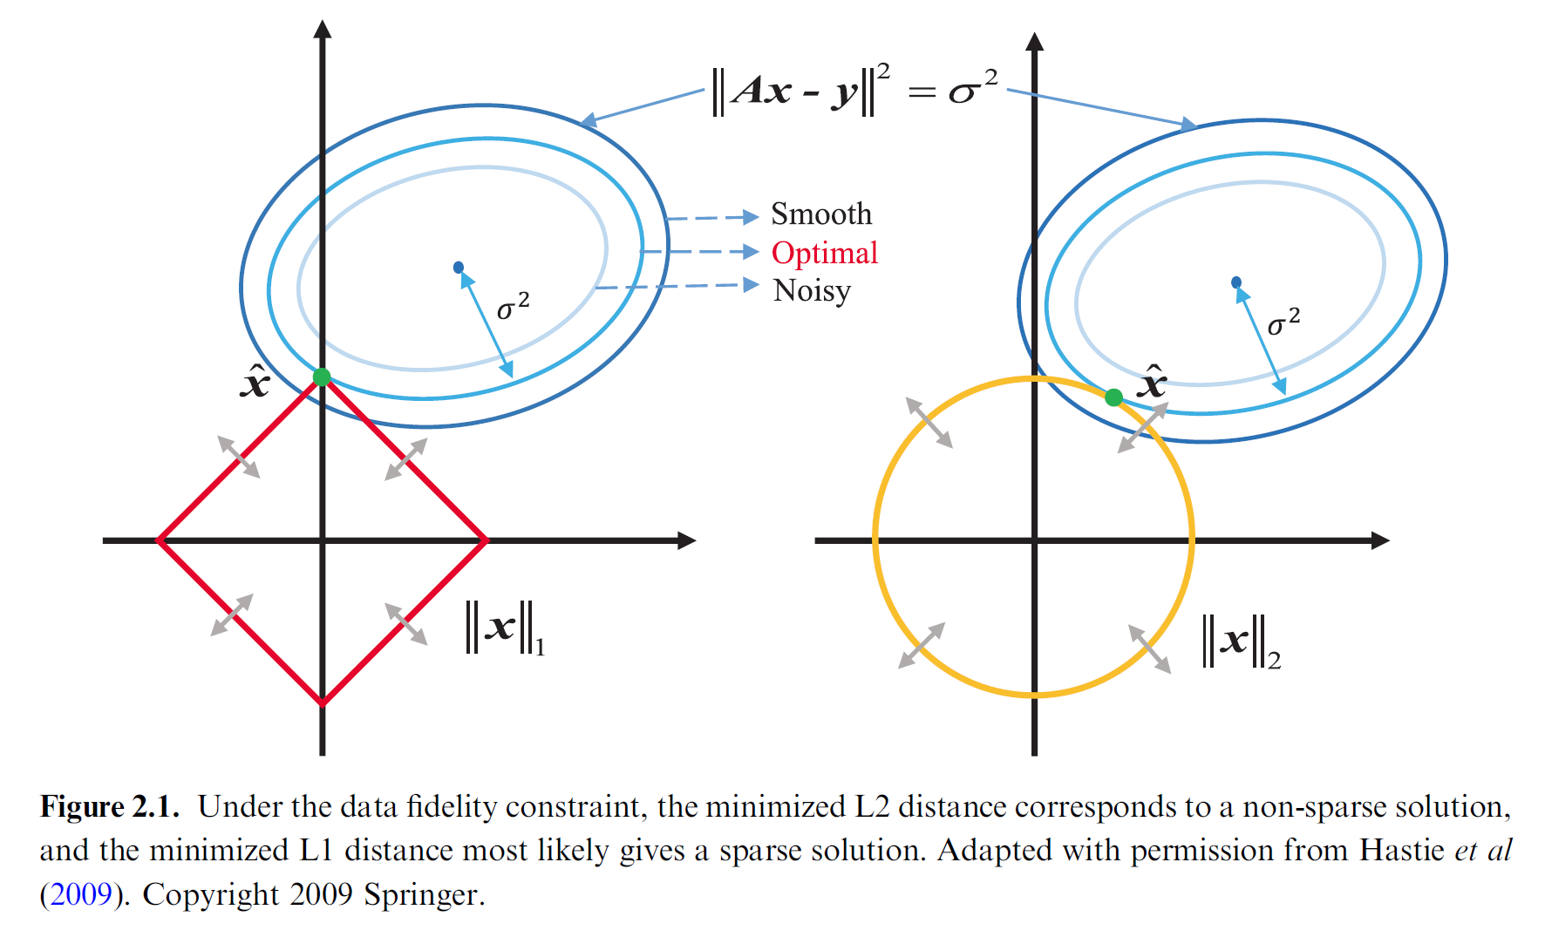
Regularized Sparse Reconstruction

Slide 20
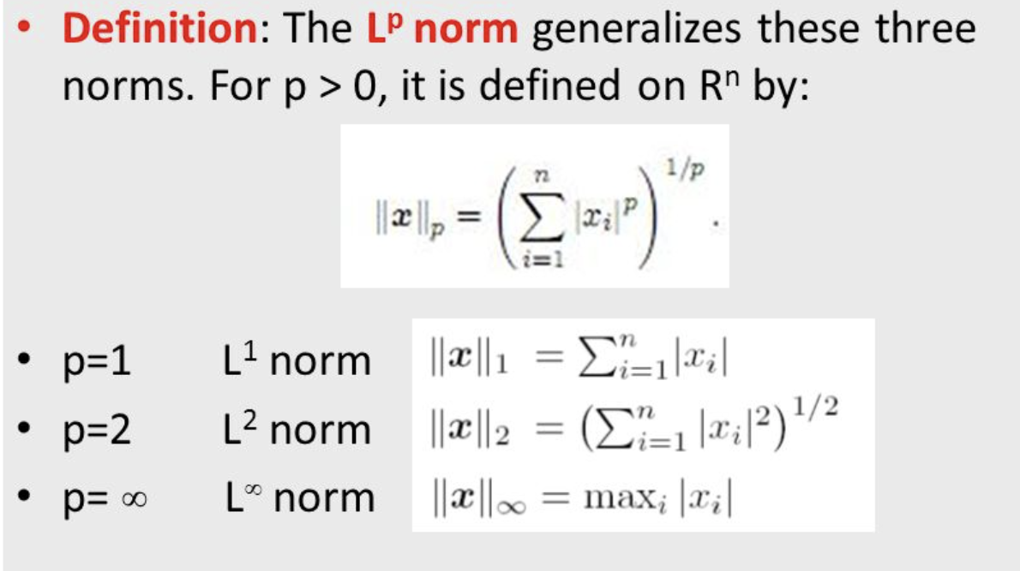
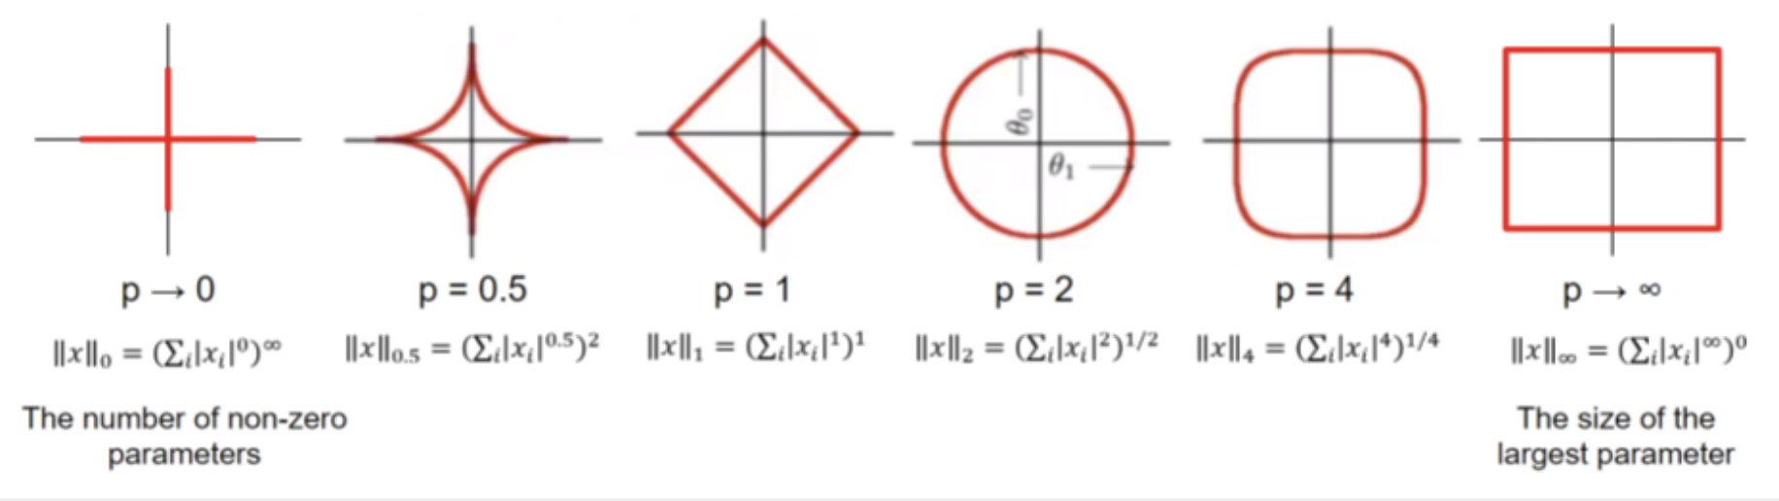

Slide 21
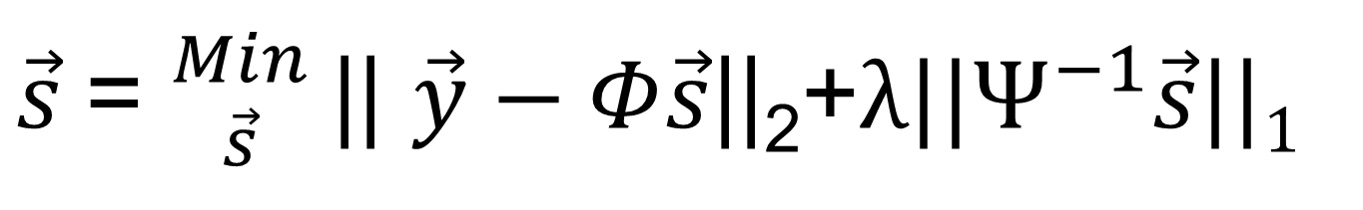
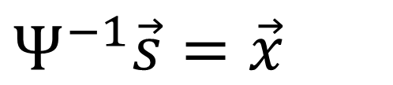
L0 Norm Replaced by L1 Norm
$$\vec{y}=Φ\vec{s}=ΦΨ\vec{x}=A\vec{x}$$
$$Ψ^{−1}\vec{s}=\vec{x}$$
Measurement
Sparsifying
$\vec{s}$= ${Min \atop \vec{s}}$|| $\vec{y}−Φ\vec{s}$||₂+${λ||Ψ}^{−1}\vec{s}||1$
Objective Function consists of two terms:
The first is data fidelity
The second is prior information

Slide 22
Homework
Do Hands-on 4 (Please follow TA’s instructions)

